Slide 1

Chaii - Hindi and Tamil Question Answering
By: Harsh Panday (panday.4)
Vritangi Kansal (kansal.17)
Nitish Reddy

Slide 2
Abstract
Machine reading context and question answering is an indispensable task in Natural Language Processing. Recently Google hosted a competition on Kaggle in which the task was to develop a model which can understand and comprehend context in Hindi and Tamil language give answers to asked questions in the respected language.
There are many models for context based question answering in English, but research on context based question answering hasn’t evolved that much, that’s the reason why we chose this competition as our AI project as we thought that this is a great initiative towards developing a natural language model for languages other than English. All 3 of us are from India and are well versed in Hindi and Tamil this is a great opportunity to work on a model for our native languages. There are almost 1 billion people in the world who speak Hindi and around 100 million who converse in Tamil, and yet these languages are underrepresented on the web. With this model we hope to advance the research in multilingual NLP models and also help Indian users to make the most out of web.

Slide 3
Literature Survey
According to the paper by YlliasChalia and Sadid A.Hasana,generally, a graph based random walk method is used to calculate the importance of sentences and texts.But the sequence, syntactic and semantic information is not considered properly as this approach(TD*IDF) gives more priority to frequency of words.They compared random walk method with Extended String Subsequence Kernel (ESSK) for a similar work and dataset and sound kernels to be more effective in terms of including syntactic and semantic information for answering difficult questions.
A paper tried to create a humanoid robot which can handle question-answering so that it can be used in the day to day life with self learning capability.Once a person asks something, this is processed using deep learning and the answer we get is compared to the corpus of the system.This process is done using Convolution Neural Network (CNN) encoder, Recurrent Neural Network (RNN) encoder, using Bidirectional Attention Flow (BiDAF).Their experiments are conducted using BiDAF for both CNN and RNN encoder and found that RNN with BiDAF has better EM/F1 score.
According to a paper by Shivani G. Aithal, Abhishek B. Rao & Sanjay Singh,Till now the question for which the answers are not available are given incorrect or unreliable answers in the QA systems..But this paper propose a new approach in which each answer is compared using the question similarity mechanism in which each question is compared with all the possible question in the corpus and each of the possible question is given a score so that we try to answer the question to the best of our capabilities based on the information we know.This will help avoid giving wrong answers and improve the performance of the Question Answering system.These automatically created question answer pairs can be used as datasets to train other question answering systems and models.
The question answering system(QAS) can be a very effective solution to be used in the internet.But medical field has been ignored in terms of the kind of research put into it.This is because of the limited amount of datasets present in the the medical field.This research is a study on deep learning techniques are reviewed on the textual question-answering systems and Medical Question-Answering systems are properly checked.hen the way to check how good and reliable the existing medical datasets are and the metrics for checking the efficiency was discussed.
Most of these existing studies are in resource-rich languages like English, which is difficult to port into the other relatively low-resource language (Hindi/Tamil). The majority of these works made use of machine translation, where questions and/or documents in less-resourced languages were translated to resource-rich language(s) like English.

Slide 4
Drawbacks of Current models
The main drawback in the current NLP models for question answering is that most of them are trained on a dataset which was in English language and the sentence construction for Hindi and Tamil is very different from English. Let’s take an example in English - “I went outside to play” is similar to Hindi- “मैं बहार खेलने गया” both of these sentences mean the same but the literal translation of the Hindi sentence word to word in English will be “I outside play went”.
This is one of the main reasons why we need a separate NLP model for Hindi and Tamil that is trained on a dataset which is in Hindi and Tamil and can understand the sentence bidirectionally (That’s why we choose BERT!!)

Slide 5
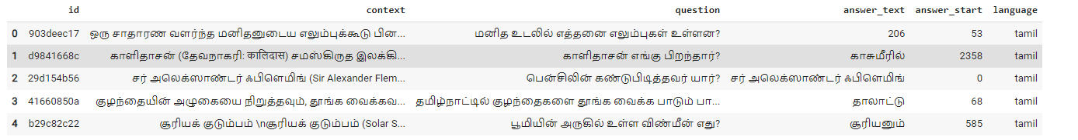
Our Dataset
Our dataset has 6 different columns for question id, context, question, answer, answer start (position in the context from where the answer starts) and language. The training dataset contains data of both Tamil and Hindi languages. About 67 percent of the data is in Hindi and 33 percent is in Tamil. Apart from this Google has also provided a testing dataset; it only has 4 columns that are id, context, question and language.

Slide 6
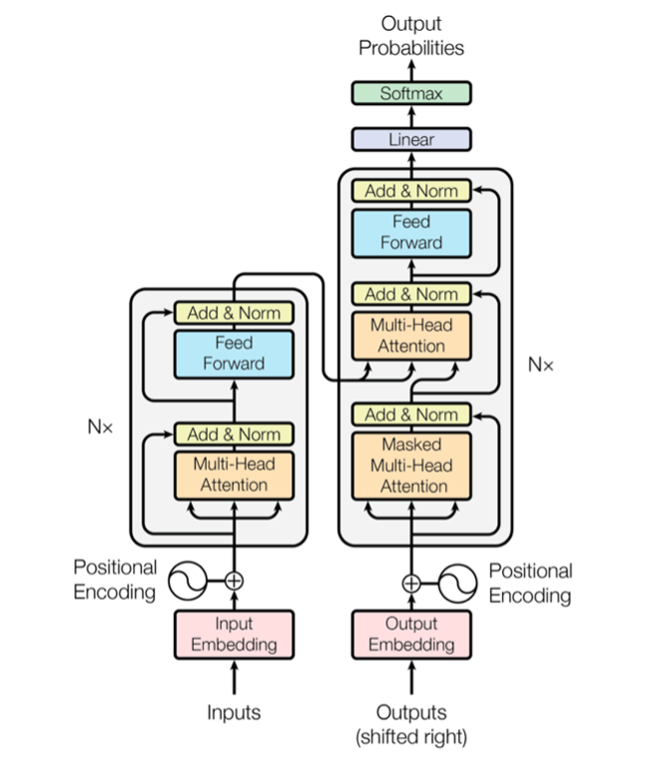
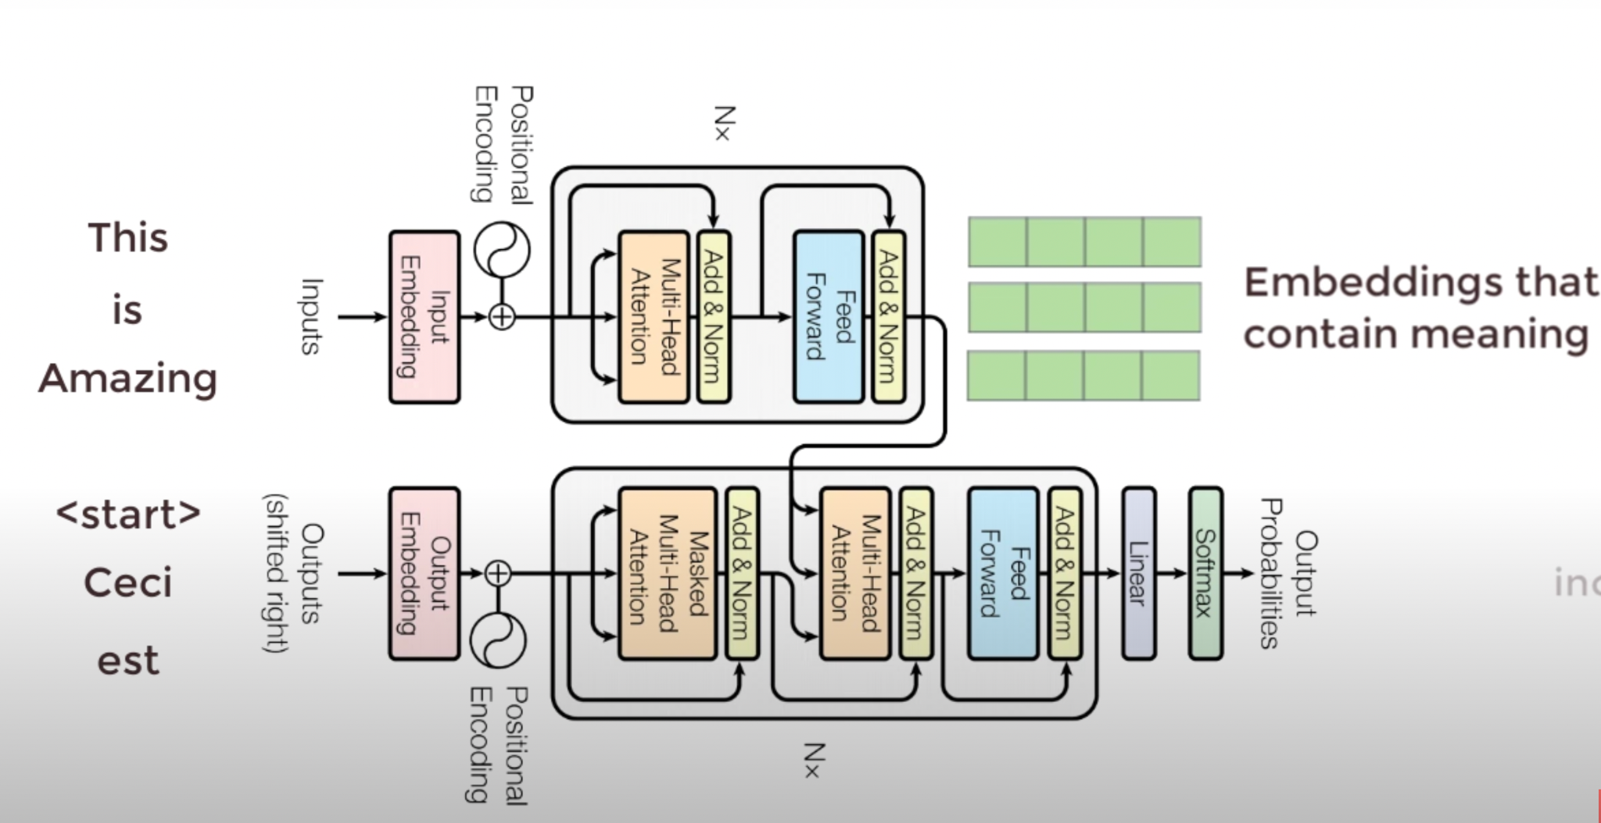
Transformers

Slide 7
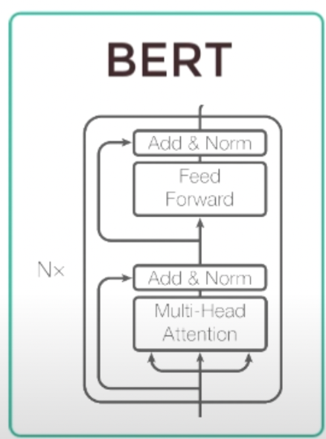
BERT
Bidirectional Encoder Representation from Transformers
Step 1: Pretrain BERT to understand language
The [MASK1] brown fox [MASK2] over the lazy dog.
Masked Language Model (MLM)
[MASK1] = quick [MASK2] = jumped
Next Sentence Prediction (NSP)
Ajay is cool dude.
He lives in Ohio
No. Sentence B does not follow Sentence A

Slide 8
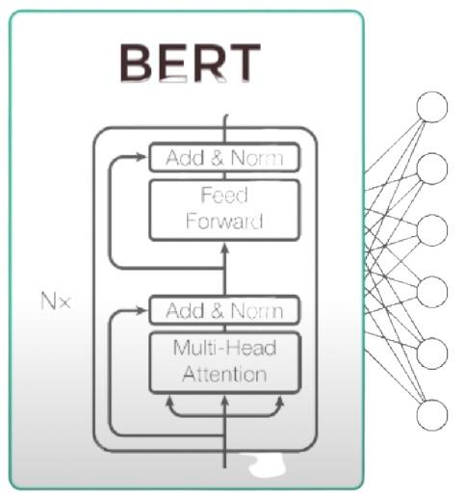
BERT
Step 2: Fine tune BERT to learn specific task
Question
Answer
Context

Slide 9
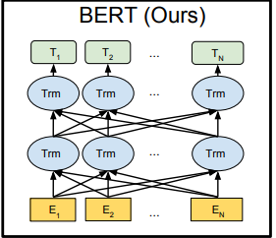
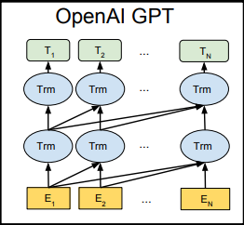
Why BERT is best suited for our project..?
The main reason why we choose BERT for our project instead of models like Open AI GPT is because BERT uses a bidirectional transformer that means it simultaneously trains from left to right and right to left in order to understand the full context of the sentence but models like Open AI GPT use a unidirectional transformer which train from left to right, this might be good for a language like English but for languages like Hindi and Tamil a bidirectional model is better suited.

Slide 10
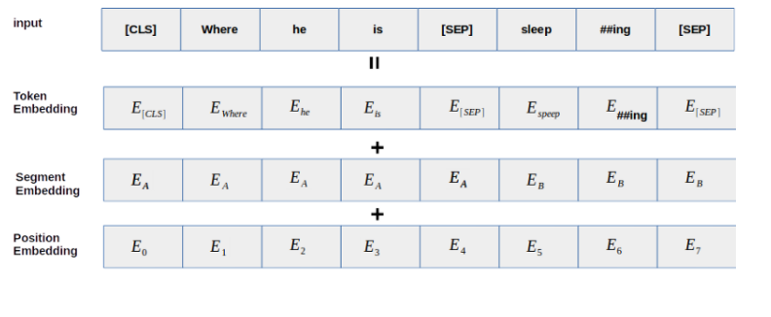
Our methodology (Fine Tuning BERT)
Data Preparation
The first step in data preparation is to use the pre trained tokenizer to create embeddings for our input data that is for context and the questions.
Let’s understand how BERT uses these embeddings:

Slide 11
Fine Tuning BERT cont...
The next step is to mark the answer in the context so that BERT can learn while training; this is where we used the “answer start” column in our training dataset. As we were given the answer and the answer start position using them we calculated the position where the answer ended and then marked the answer as 1 in the context and the rest of the context was marked 0. Then we stored the embeddings, the masks and the answer start and end token in a dictionary, so that we can feed it to BERT to train.
So for our case this would look something like this
*This is just an example, we don’t actually mark the words themselves instead we mark their embeddings.
Then we append all the embeddings, answer start and end token into a dictionary, in order to feed the data to BERT.

Slide 12

Building model and finalizing parameters
After processing the input now we just have to finalize some parameters, for our model we decided to use the following parameters:
Loss function : Sparse Categorical Entropy
Learning rate : 1e-5
Optimizer: Adam
Now we are finally ready to fine-tune the BERT for our model!!

Slide 13
Example of some great results given by our model!!
In the below table question is “Where is India’s Army base situated?” and the answer is “New Delhi”, as we can see in the context there is a line given which answers the question “New Delhi situated Army base”, this is where the bidirectional transformer of BERT is very useful, as it can understand context from left to right and right to left simultaneously allowing it to understand that “Army base is situated in New Delhi”.
ID | Context | Question | Answer predicted | Answer start | Language
612852f39 | …नई दिल्ली में स्थित सेना मुख्यालय से सीधे जुड़ा हुआ है…. | भारतीय सेना का मुख्यालय कहा पर है? | नई दिल्ली | 6371 | hindi

Slide 14
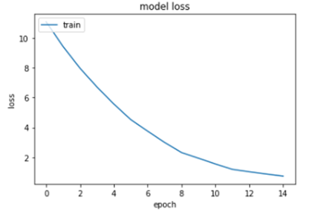
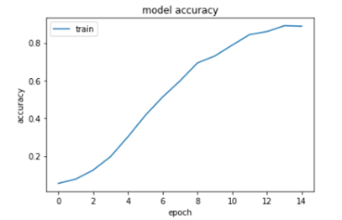
Results
After training for 15 epochs using a learning rate of 1e-5, we got the following results
Loss | Accuracy
0.7382 | 88.76%

Slide 15
Results cont...
Along with the training dataset, google also provided a small testing dataset, just to see if our model is accurate enough or not.
Below table shows the prediction of our model on the testing dataset.
ID | Question | Start index | End Index | Answer (predicted) | Answer (actual)
22bff3dec | ज्वाला गुट्टा की माँ का नाम क्या है, | 68.0 | 78.0 | की माँ का नाम येलन गुट | येलन गुट
282758170 | गूगल मैप्स कब लॉन्च किया गया था? | 8.0 | 11.0 | 8 फरवरी 2005 | 8 फरवरी 2005
d60987e0e | गुस्ताव किरचॉफ का जन्म कब हुआ था?, | 18.0 | 20.0 | १८२४ | १८२४
f99c770dc | அலுமினியத்தின் அணு எண் என்ன? | 1.0 | 331.0 | மாய் பயன்படுத்தி வந்துள்ளனர். 13 அலுமினியத்தின் ம | 13
40dec1964 | இந்தியாவில் பசுமை புரட்சியின் தந்தை என்று கருதப்படுபவர் யார்? | 46.0 | 222.0 | ந்திக்கப்பட்டு, 1844ஆம் ஆண்டில் அவரது நண்பர்கள திரு.சுவாமிநாதன் | திரு.சுவாமிநாதன்

Slide 16

Conclusion + Future Work
Take into account different grammar used in different dialects of the same language.
Fine-tune further on specific domains like healthcare, telecom, ecommerce chatbot etc.
Expand reader model to open domain Question Answering system.
Scale up models(ALBERT, XLM-ROBERTA) and datasets to work on cross lingual question answering.

